Slide 1
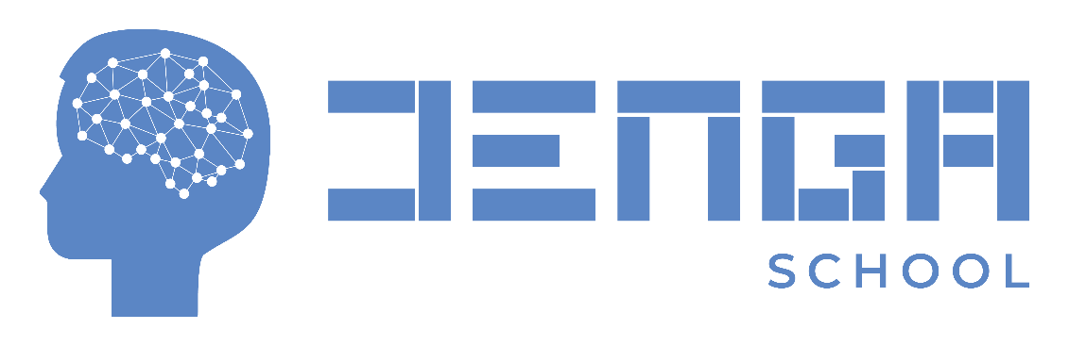
Black-jack Game
Name: Edwin Munyiri King’ori
Program: PYTHON PROGRAMMING FOR ALL
Date: 2/28/2023

Slide 2
PROBLEM STATEMENT
I completed the project to enhance the skills and knowledge acquired during the classwork. The project entails automating a blackjack game on a command line interface.
Blackjack is a popular card game played in casinos around the world. The main objective of the game is to have a hand of cards whose total value is equal to or close to 21 without surpassing.
Before the game begins, players place their bets by placing chips on the designated betting area on the table.

Slide 3
PROBLEM STATEMENT
The dealer gives two cards to each player and retains two cards to themselves. The dealer's first card is dealt face up, while the second card is dealt face down.
Calculating the hand value: Players add up the total value of their cards. Cards 2 through 10 are worth their face value, face cards (Kings, Queens, and Jacks) are worth 10 points each, and Aces can be worth 1 or 11 points, depending on the player's choice.
Playing the hand: The player can choose to "hit" (ask for another card) to increase their hand value, or "stand" (keep their current hand). Players can continue to hit until they decide to stand or their hand value exceeds 21.
Dealer's turn: After all players have completed their turns, the dealer reveals their face-down card. If the dealer's hand is less than 17, they must continue to hit until their hand value is 17 or greater. If the dealer's hand exceeds 21, all remaining players win.

Slide 4
PROBLEM STATEMENT
Determining the winner: The player with a hand value closer to 21 than the dealer's hand value wins. If the player's hand value exceeds 21, they lose the game. If the player and dealer have the same hand value, it's a tie, and the player's bet is returned.

Slide 5
Project goals
The main goal programming the blackjack game help me improve my python programming skills and gain experience with various concepts and tools such as using functions, classes, loops, methods and objects.
Combining the use of python data structures, functions, classes and loops helped me to think critically and logically to implement the game's rules and mechanics.
Attempting to automate the game provided a fun learning experience and the goals was to experience an engaging approach to learn skills that could be applied in real-world applications.

Slide 6
Methods and tools
I wrote the code in Python 3 and utilized Visual Studio Code that as an integrated terminal, which allowed me to debug and check the required output.
The first step was to define the game's rules and structure. The game required a deck of cards, a dealer, and one or more players. The deck of cards could be created using Python's built-in data structures, such as lists and dictionaries.
Once the game's rules and structure were defined, the next step was to write the code that implemented the game's logic. Using Visual studio code helped to write, test, and debug the code until I had a working game.

Slide 7
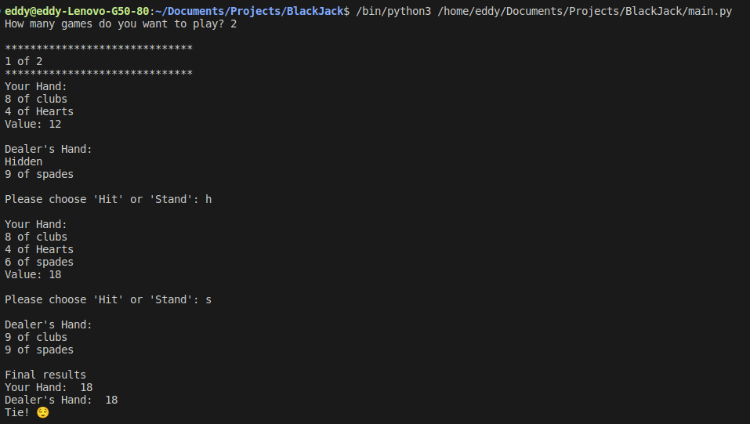
results

Slide 8
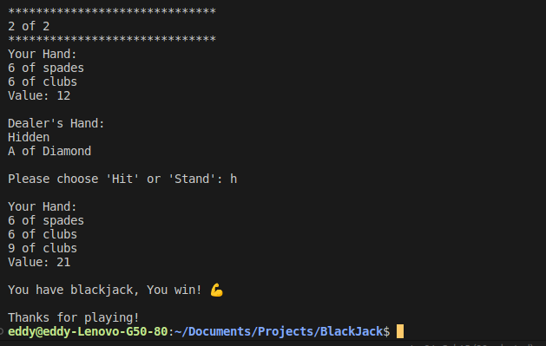
results

Slide 9
conclusion
Improvements
I am looking to enhance user interactive-ness by developing a user interface using Django, which will enhance user-friendliness and increase satisfaction. By using Django to develop a user interface, I aim at providing users with a simple graphical user interface (GUI) for playing the Black jack game, which is more user-friendly than a command-line interface (CLI).

Slide 10
conclusion
Observation
One of the main observations made was the powerful utilization of classes. One of the benefits of using classes was maintaining the data methods together. Thus, helping to keep the code organized. Classes also provided with the inheritance functionality. Class inheritance is a powerful feature of object-oriented programming that allows classes to inherit attributes and methods from other classes.
Given that most of the classwork was based on functional programming, implementing classes in the game project helped in identifying the differences between the two paradigms. For instance, Function declarations, expressions can be overwritten, while classes are mostly extended. For this reason, I observed that functions ae great to utilize when data is central to the work being implemented, while classes work best when a collection of methods and attributes is required to be re-used again in other places.

Slide 11
conclusion
Challenges faced
Implementing classes and their different methods, such inheritance, in my code was difficult for me. To learn more about its applications, I used the tutorials and the materials given in class. The courses also aided me in overcoming obstacles I ran into while writing the code, and I can now say that it was a worthy task.
Debugging: Debugging is a necessary part of programming, and it can be time-consuming and frustrating. In this case, debugging the code was a challenge and had to use various resources such as stack-overflow and YouTube, which helped in identifying and fixing underlying errors.

